Slide 1

Hey are you tired of finding favourite books online?
If yes , here we come with the solution.

Slide 2
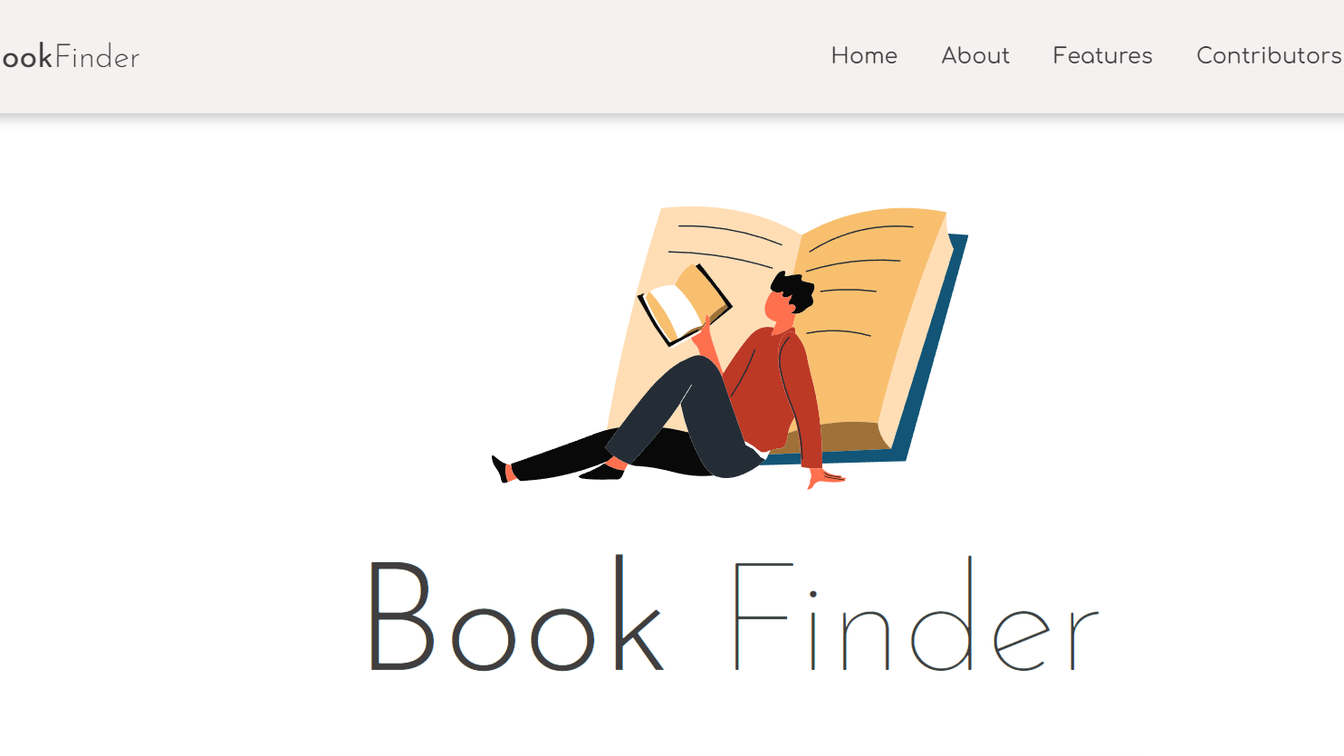
Our community brings you –"Book finder"

Slide 3

What is " Book Finder"
Book Finder is your go-to place for all kinds of book related searches, need to read a book but don't know where to find it? We got your back! Started in 2022, we are an open-source free search engine with over a million books and more to find out. Here you won't just be able to read books but also listen to them. So what are you waiting for? Search your favourite book right now!

Slide 4

Feature of "Book Finder"
With lots of e-books available here, you have ability to search through an entire book in seconds.
Here, you can not just read the book but we have the another super option which is you can also listen the summary of book .
Our Book finder has two mode - light and dark mode for user comfortability and benefits.

Slide 5
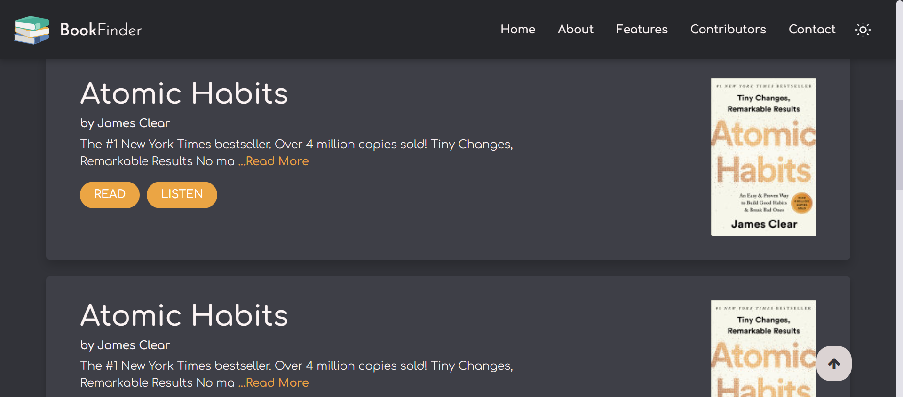
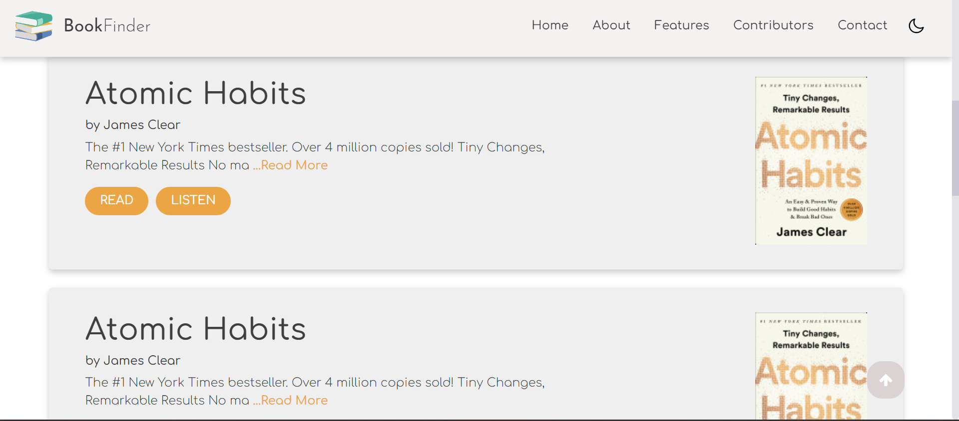
Our book finder comes with two modes
Dark mode
Light mode

Slide 6

Book Finder
Develop by DEVELOPER COMMUNITY

